Slide 1
G85R vs WT (M + F)
John Santiago

Slide 2
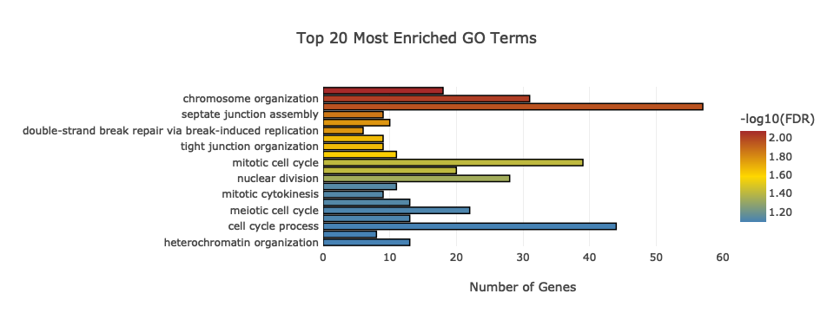
##GO and KEGG Enrichment function
##GO.Sim.PCA function
##GO20 Function
##KEGG20 Function
BP.GO.fig

Slide 3
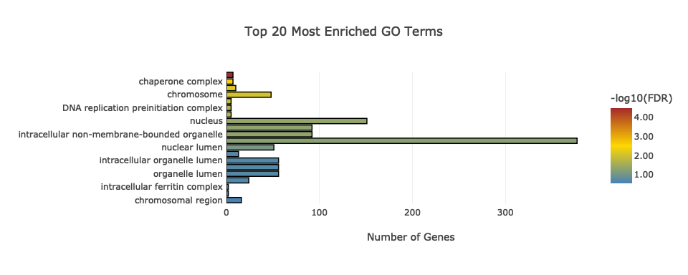
CC.GO.fig

Slide 4
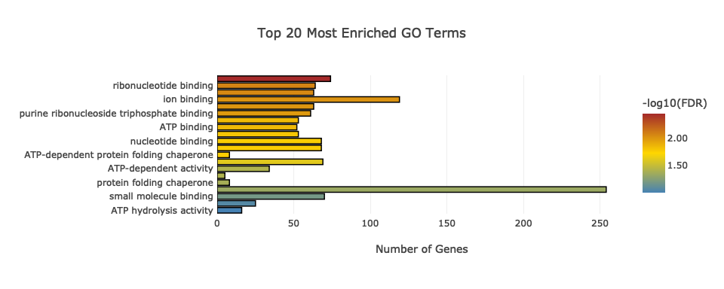
MF.GO.fig

Slide 5
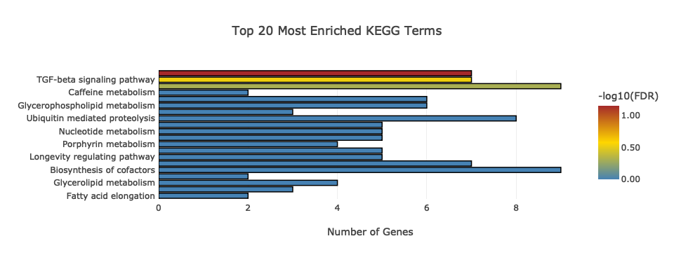
KEGG.fig

Slide 6
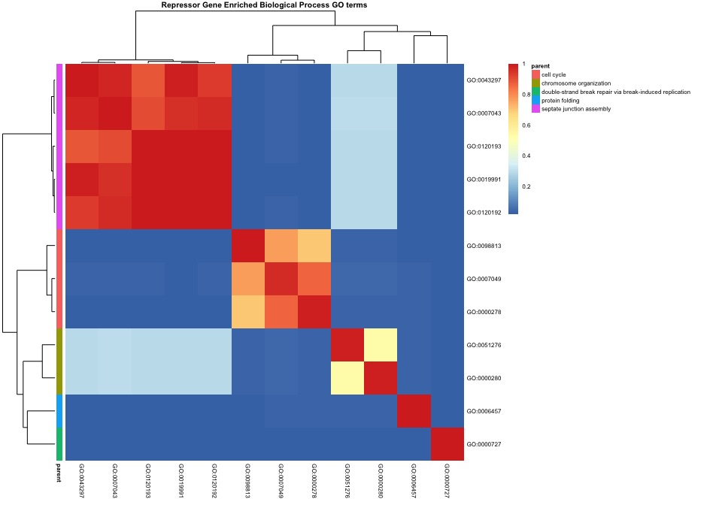
heatmapPlot(simMatrix, reducedTerms, annotateParent=TRUE, annotationLabel="parentTerm", fontsize=6, main = "Repressor Gene Enriched Biological Process GO terms")

Slide 7
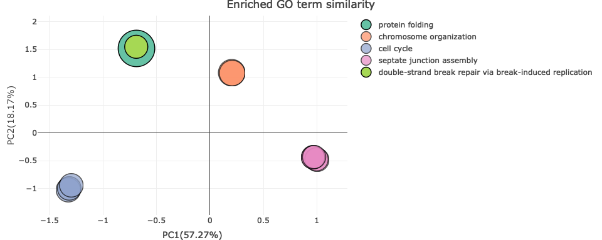
use.data = simMatrix GO.Sim.PCA(use.data)

Slide 8
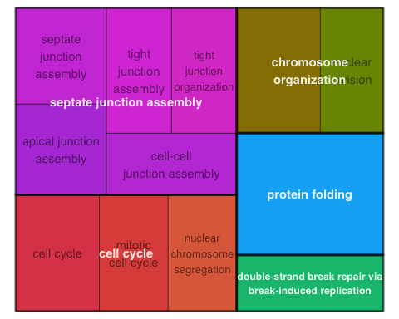
treemapPlot(reducedTerms)

Slide 9
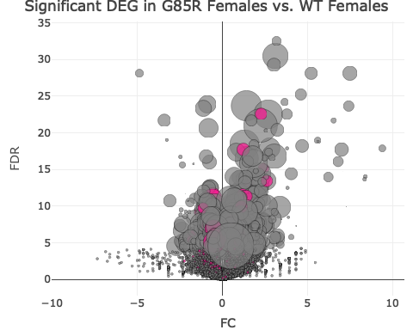
##GR.F vs WT.F specific volcano specific.cat = c('none', 'parent.category', 'specific.kegg', 'specific.go') specific.cat = specific.cat[1] parent.category = 'neurogenesis' specific.kegg = "DNA replication" specific.go = '32553' Synaptic.genes = F set.size = F GOterm.genes = vector('list', length = length(unique(reducedTerms$parent))) names(GOterm.genes) = unique(reducedTerms$parent) i=1 while(i<=length(GOterm.genes)){ goinparent = reducedTerms[grep(names(GOterm.genes)[i], reducedTerms$parent),'go'] genesinparent = unlist(genesingo[goinparent]) GOterm.genes[[i]] = GeneIDKey[GeneIDKey$ensembl %in% genesinparent, 'FBgn'] i = i +1 } volcano.data = data.frame(Symbol = GeneIDKey[row.names(TKT.EdgeR), "Symbol"], FDR = -log2(TKT.EdgeR[, 'GRxWT.FC']), FC = TKT.EdgeR.FC[row.names(TKT.EdgeR), 'GRxWT.FC'], ##Color = 0) Color = 'grey', size = 5*log(mean.cpm[row.names(TKT.EdgeR),"GR.F"]), GR.F.cpm = mean.cpm[row.names(TKT.EdgeR),"GR.F"], WT.F.cpm = mean.cpm[row.names(TKT.EdgeR),"WT.F"], GO.terms = "none") main.title = "Significant DEG in G85R Females vs. WT Females" volcano.data$Color[volcano.data$FDR >= -log2(.05) & volcano.data$FC < 0] = 'lightblue' volcano.data$Color[volcano.data$FDR >= -log2(.0001) & volcano.data$FC < 0] = 'steelblue' volcano.data$Color[volcano.data$FDR >= -log2(.000001) & volcano.data$FC < 0] = 'dodgerblue' volcano.data$Color[volcano.data$FDR >= -log2(.05) & volcano.data$FC > 0] = 'lightcoral' volcano.data$Color[volcano.data$FDR >= -log2(.0001) & volcano.data$FC > 0] = 'tomato' volcano.data$Color[volcano.data$FDR >= -log2(.000001) & volcano.data$FC > 0] = 'firebrick' volcano.data$size[volcano.data$FDR <= -log2(.05)] = 3 if(set.size == T){ volcano.data$size = 15 volcano.data$size[volcano.data$FDR <= -log2(.05)] = 5 } volcano.data$Color = 'grey' volcano.data$Color[volcano.data$Symbol %in% Synaptic$Symbol] = 'deeppink' if(specific.cat == 'parent.category'){ parent.genes = GOterm.genes[[intersect(reducedTerms[reducedTerms$parentTerm == parent.category, "go"], names(GOterm.genes))]] volcano.data$Color = 'honeydew' volcano.data[parent.genes, 'Color'] = 'deeppink' volcano.data = volcano.data[order(volcano.data$Color, decreasing = T),] main.title = sig.cats$GO[c(grep(parent.category, sig.cats$GO$term), grep(parent.category, sig.cats$GO$category)), 'term'] } if(specific.cat == 'specific.kegg'){ kegg.id = sig.cats$KEGG[c(grep(specific.kegg, sig.cats$KEGG$Name), grep(specific.kegg, sig.cats$KEGG$category)), 'category'] kegg.genes = names(kegg[grep(kegg.id, kegg)]) volcano.data$Color = 'honeydew' row.names(volcano.data) = volcano.data$Symbol volcano.data[kegg.genes, 'Color'] = 'deeppink' volcano.data = volcano.data[order(volcano.data$Color, decreasing = T),] main.title = sig.cats$KEGG[c(grep(specific.kegg, sig.cats$KEGG$Name), grep(specific.kegg, sig.cats$KEGG$category)), 'Name'] } if(specific.cat == 'specific.go'){ go.id = sig.cats$GO[c(grep(specific.go, sig.cats$GO$term), grep(specific.go, sig.cats$GO$category)), 'category'] volcano.data$Color = 'honeydew' go.genes = genesingo[[go.id]] go.genes = GeneIDKey[GeneIDKey$ensembl %in% go.genes, "FBgn"] go.genes = intersect(go.genes, row.names(volcano.data)) volcano.data[go.genes, 'Color'] = 'deeppink' volcano.data = volcano.data[order(volcano.data$Color, decreasing = T),] main.title = sig.cats$GO[c(grep(specific.go, sig.cats$GO$term), grep(specific.go, sig.cats$GO$category)), 'term'] } ##volcano.data fig = plot_ly(data = volcano.data, x = ~FC, y = ~FDR, type = 'scatter', mode = 'markers', marker = list(color = ~Color, colors = ~Color, size = volcano.data$size, line = list(color = 'black', width = .5)), hoverinfo = "text", hovertext = paste("Gene:", volcano.data$Symbol, "\n-log2(FDR): ", round(volcano.data$FDR,2), "\nFC: ", round(volcano.data$FC,2), "\nG85R mean cpm: ", round(volcano.data$GR.F.cpm, 1), "\nWT mean cpm: ", round(volcano.data$WT.F.cpm, 1))) fig = fig %>% layout(title = main.title) ##color = ~Color, ##colors = 'Spectral') ##color = ~Color, ##colors = ~Color) ##marker = list(colorscale = list(c(0,.5,1), c("blue","yellow", "red")), color = ~Color)) fig

Slide 10
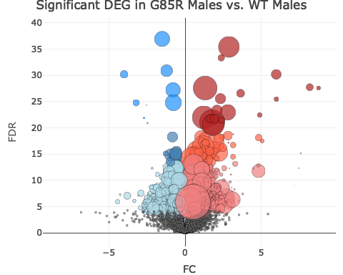
specific.cat = c('none', 'parent.category', 'specific.kegg', 'specific.go') specific.cat = specific.cat[1] parent.category = 'chromosome organization' specific.kegg = "DNA replication" specific.go = '006457' set.size = F GOterm.genes = vector('list', length = length(unique(reducedTerms$parent))) names(GOterm.genes) = unique(reducedTerms$parent) i=1 while(i<=length(GOterm.genes)){ goinparent = reducedTerms[grep(names(GOterm.genes)[i], reducedTerms$parent),'go'] genesinparent = unlist(genesingo[goinparent]) GOterm.genes[[i]] = GeneIDKey[GeneIDKey$ensembl %in% genesinparent, 'FBgn'] i = i +1 } volcano.data = data.frame(Symbol = GeneIDKey[row.names(TKT.EdgeR), "Symbol"], FDR = -log2(TKT.EdgeR[, 'GRxWT.MC']), FC = TKT.EdgeR.FC[row.names(TKT.EdgeR), 'GRxWT.MC'], ##Color = 0) Color = 'grey', size = 5*log(mean.cpm[row.names(TKT.EdgeR),"GR.M"]), GR.F.cpm = mean.cpm[row.names(TKT.EdgeR),"GR.M"], WT.F.cpm = mean.cpm[row.names(TKT.EdgeR),"WT.M"], GO.terms = "none") main.title = "Significant DEG in G85R Males vs. WT Males" volcano.data$Color[volcano.data$FDR >= -log2(.05) & volcano.data$FC < 0] = 'lightblue' volcano.data$Color[volcano.data$FDR >= -log2(.0001) & volcano.data$FC < 0] = 'steelblue' volcano.data$Color[volcano.data$FDR >= -log2(.000001) & volcano.data$FC < 0] = 'dodgerblue' volcano.data$Color[volcano.data$FDR >= -log2(.05) & volcano.data$FC > 0] = 'lightcoral' volcano.data$Color[volcano.data$FDR >= -log2(.0001) & volcano.data$FC > 0] = 'tomato' volcano.data$Color[volcano.data$FDR >= -log2(.000001) & volcano.data$FC > 0] = 'firebrick' volcano.data$size[volcano.data$FDR <= -log2(.05)] = 3 if(set.size == T){ volcano.data$size = 15 volcano.data$size[volcano.data$FDR <= -log2(.05)] = 5 } if(specific.cat == 'parent.category'){ parent.genes = GOterm.genes[[intersect(reducedTerms[reducedTerms$parentTerm == parent.category, "go"], names(GOterm.genes))]] volcano.data$Color = 'honeydew' volcano.data[parent.genes, 'Color'] = 'deeppink' volcano.data = volcano.data[order(volcano.data$Color, decreasing = T),] main.title = sig.cats$GO[c(grep(parent.category, sig.cats$GO$term), grep(parent.category, sig.cats$GO$category)), 'term'] } if(specific.cat == 'specific.kegg'){ kegg.id = sig.cats$KEGG[c(grep(specific.kegg, sig.cats$KEGG$Name), grep(specific.kegg, sig.cats$KEGG$category)), 'category'] kegg.genes = names(kegg[grep(kegg.id, kegg)]) volcano.data$Color = 'honeydew' row.names(volcano.data) = volcano.data$Symbol volcano.data[kegg.genes, 'Color'] = 'deeppink' volcano.data = volcano.data[order(volcano.data$Color, decreasing = T),] main.title = sig.cats$KEGG[c(grep(specific.kegg, sig.cats$KEGG$Name), grep(specific.kegg, sig.cats$KEGG$category)), 'Name'] } if(specific.cat == 'specific.go'){ go.id = sig.cats$GO[c(grep(specific.go, sig.cats$GO$term), grep(specific.go, sig.cats$GO$category)), 'category'] volcano.data$Color = 'honeydew' go.genes = genesingo[[go.id]] go.genes = GeneIDKey[GeneIDKey$ensembl %in% go.genes, "FBgn"] go.genes = intersect(go.genes, row.names(volcano.data)) volcano.data[go.genes, 'Color'] = 'deeppink' volcano.data = volcano.data[order(volcano.data$Color, decreasing = T),] main.title = sig.cats$GO[c(grep(specific.go, sig.cats$GO$term), grep(specific.go, sig.cats$GO$category)), 'term'] } ##volcano.data fig = plot_ly(data = volcano.data, x = ~FC, y = ~FDR, type = 'scatter', mode = 'markers', marker = list(color = ~Color, colors = ~Color, size = volcano.data$size, line = list(color = 'black', width = .5)), hoverinfo = "text", hovertext = paste("Gene:", volcano.data$Symbol, "\n-log2(FDR): ", round(volcano.data$FDR,2), "\nFC: ", round(volcano.data$FC,2), "\nG85R mean cpm: ", round(volcano.data$GR.F.cpm, 1), "\nWT mean cpm: ", round(volcano.data$WT.F.cpm, 1))) fig = fig %>% layout(title = main.title) fig

Slide 11
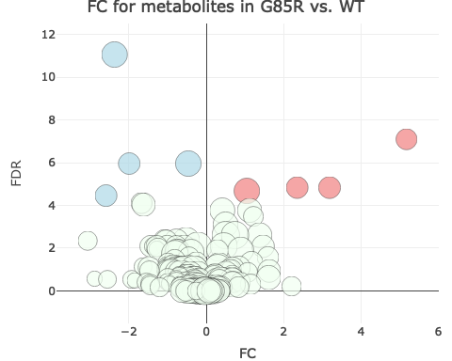
rawdata = read.csv("/Users/johncsantiago/Documents/GitHub/WhartonLab/Metabolomics/MetabolomicsForMetaboanalyst.txt", sep = "\t", row.names = 1) KEGG.Key = read.csv("/Users/johncsantiago/Documents/GitHub/WhartonLab/Metabolomics/RawMetabolomicData.csv", row.names = 1) KEGG.Key = setNames(KEGG.Key[-c(1:2), 2], row.names(KEGG.Key)[-c(1:2)]) genotypes = setNames(c("WT", "GR", "TktOEWT", "TktOEGR", "TktDfWT", "TktDfGR"), c("C", "E", "A", "F", "B", "D")) metadata = data.frame(Sample = colnames(rawdata), Group = as.character(rawdata[1,]), TIC = as.numeric(rawdata[2,]), Genotypes = genotypes[as.character(rawdata[1,])]) norm.func = function(data){ nd = (as.numeric(data)/metadata$TIC)*1000 return(nd) } norm.data = t(apply(rawdata[3:nrow(rawdata),], 1, norm.func)) colnames(norm.data) = colnames(rawdata) group.mean=function(data){ gm = mean(na.omit(data)) } mean.data = matrix(0, nrow=nrow(norm.data), ncol = length(genotypes)) row.names(mean.data) = row.names(norm.data) colnames(mean.data) = unique(metadata$Group) i=1 while(i<=ncol(mean.data)){ mean.data[,i] = apply(norm.data[,metadata[metadata$Group == colnames(mean.data)[i], "Sample"]], 1, group.mean) i = i+1 } compare.conditions = function(condition1, condition2){ columns1 = metadata[metadata$Group == condition1, "Sample"] columns2 = metadata[metadata$Group == condition2, "Sample"] p=setNames(rep(NA, nrow(norm.data)), row.names(norm.data)) i=1 while(i<=length(p)){ if(length(na.omit(norm.data[i,columns1]))>2 & length(na.omit(norm.data[i,columns2]))>2){ temp = t.test(na.omit(norm.data[i,columns1]), na.omit(norm.data[i,columns2]), paired = F, var.equal = T) p[i] = temp[[3]] } i=i+1 } fdr = p.adjust(p, "BH", length(p)) fc = mean.data[,condition1]/mean.data[,condition2] comparison.table = data.frame(p = p, FDR = fdr, FC = fc, KEGG = KEGG.Key[row.names(mean.data)]) comparison.table = comparison.table[order(comparison.table$FDR),] } GRxWT.C = compare.conditions("E", "C") GRxWT.Df = compare.conditions("D", "B") GRxWT.OE = compare.conditions("F", "A")
set.size == F
## [1] TRUE
volcano.data = data.frame(Symbol = row.names(GRxWT.C), FDR = -log2(GRxWT.C$FDR), FC = log2(GRxWT.C$FC), Color = 'honeydew', size = log(mean.data[row.names(GRxWT.C),'E']), GR.Level = mean.data[row.names(GRxWT.C), "E"], WT.Level = mean.data[row.names(GRxWT.C), "C"], GO.terms = "none") main.title = "FC for metabolites in G85R vs. WT" volcano.data$Color[volcano.data$FDR >= -log2(.05) & volcano.data$FC < 0] = 'lightblue' volcano.data$Color[volcano.data$FDR >= -log2(.0001) & volcano.data$FC < 0] = 'steelblue' volcano.data$Color[volcano.data$FDR >= -log2(.000001) & volcano.data$FC < 0] = 'dodgerblue' volcano.data$Color[volcano.data$FDR >= -log2(.05) & volcano.data$FC > 0] = 'lightcoral' volcano.data$Color[volcano.data$FDR >= -log2(.0001) & volcano.data$FC > 0] = 'tomato' volcano.data$Color[volcano.data$FDR >= -log2(.000001) & volcano.data$FC > 0] = 'firebrick' ##volcano.data$size[volcano.data$FDR <= -log2(.05)] = 3 if(set.size == T){ volcano.data$size = 15 volcano.data$size[volcano.data$FDR <= -log2(.05)] = 5 } fig = plot_ly(data = volcano.data, x = ~FC, y = ~FDR, type = 'scatter', mode = 'markers', marker = list(color = ~Color, colors = ~Color, size = volcano.data$size, line = list(color = 'black', width = .5)), hoverinfo = "text", hovertext = paste("Metabolite:", volcano.data$Symbol, "\n-log2(FDR): ", round(volcano.data$FDR,2), "\nFC: ", round(volcano.data$FC,2), "\nG85R mean cpm: ", round(volcano.data$GR.Level, 1), "\nWT mean cpm: ", round(volcano.data$WT.Level, 1))) fig = fig %>% layout(title = main.title) fig
## Warning: Ignoring 71 observations

